Slide 1
Implementation of Lung Cancer Nodule Detection

Slide 2

Implementation of Lung Cancer Nodule Detection
by
Maramwar Siddharaj [ Roll No A- 28 ] [ PRN 71630852f ]
Patil Sarang [ Roll No B- 06 ] [ PRN 71726099c ]
Damkonwar Shubham [ Roll No B- 28 ] [ PRN 71751678e ]
Gawande Mahesh [ Roll No A- 18 ] [ PRN 71630644b ]
Under the Guidance of
Prof. Prof. Neha Jamdar
Academic Year 2019-20
SKN SINHGAD INSTITUTE OF TECHNOLOGY AND SCIENCE, LONAVALA

Slide 3
Index
Abstract
Synopsis
Technical Keyword
Introduction
Literature Survey
Existing System
Limitations
Proposed System
Key Contribution of work
Domain Analysis
SRS
Architecture
Algorithm
Conclusion
References

Slide 4
Abstract
In this project, we performed a comprehensive simulation to explore the quantitative accuracy of sub-centimeter nodules using the Otsu, Watershed and GLCM technique.
Images were reconstructed using motion-compensation ordered subset expectation Otsu thresholding algorithm.
The results from this studies were consistent. Segmentation using the watershed transform works better to identify foreground objects and background locations.
GLCM feature will be computed from the detected lung nodule in CT image, finally by using machine learning algorithm we detect actual lung cancer nodule.

Slide 5
Synopsis
Objective
To detect Lung Nodule Accurately.
To detect the area of nodule.
Scope
The Scope of our project is to apply this scheme for private or government hospital to track accurate nodule of the lung with the area.
Motivation
Doctors used to predict the cancer by looking at the Scanned images manually.
It affect to recognising the disease at early stage.
Exact percentage of cancer not detected manually.

Slide 6
Technical Keywords
Cancer Detection
Image processing
Feature extraction
Enhancement Watershed
GLCM

Slide 7
Introduction
Lung cancer
It is a disease of abnormal cells multiplying and growing into a tumor.
Cancer cells can be carried away from the lungs in blood, or lymph fluid that surrounds lung tissue.
Pre-processing
Otsu Thresholding
Image Segmentation
Watershed segmentation
Feature Extraction
GLCM feature compute from the detected lung nodule in CT image

Slide 8
Literature Survey
Sr. No. | Paper Name | Publication Year | Author | Concept | Algorithm
1 | A morphological operation-based approach for Subpleural lung nodule detection from CT images | 4th Middle East Conference on Biomedical Engineering (MECBME), IEEE, 2018 | Rekka Mastouri, Henda Neji, Saoussen Hantous-Zannad, Nawres Khlifa | This paper is focus on an automatic segmentation approach of sub-pleural lung nodules from Computed Tomography (CT) scans based on morphological operations. Because the extraction of sub-pleural nodules is challenging and a computer-aided diagnosis system is, hence, indispensable. The proposed system is divided into three steps: pre-processing, initial detection of sub-pleural lung nodule and post-processing. | Binarization & Image thresholding

Slide 9
Literature Survey
Sr. No. | Paper Name | Publication Year | Author | Concept | Algorithm
2 | Automatic lung nodules detection in computed tomography images using nodule filtering and neural networks | 22nd Iranian Conference on Electrical Engineering (ICEE 2014), May 20-22, IEEE, 2014 | A.R. Talebpour, H.R. Hemmati, M. Zarif Hosseinian | The proposed system implements a computer-aided detection (CAD) system that detects small size nodules (larger 3 mm) in High Resolution CT (HRCT) images. It used a cylindrical filter for filtering nodule cases from other objects in images. They use a lung LIDC image database. | Feed Forward Neural Network

Slide 10
Literature Survey
Sr. No. | Paper Name | Publication Year | Author | Concept | Algorithm
3 | A Computer Aided Diagnosis for detection and classification of lung nodules | 9th International Conference on Intelligent Systems and Control (lSCO), IEEE, 2015 | Lakshmi N arayanan A , Prof. Jeeva J.B | The aim of proposed system is to develop an efficient Computer Aided Diagnosis (CAD) for detection of lung nodules. The proposed system consists of following steps: i) the image taken is enhanced initially and then the region of interest is cropped, where the user can select the area to be cropped. ii) Morphological operation is performed to suppress the blood vessels and enhance the nodules. iii) Nodules are identified by labeling. iv) Features extraction. v) Neural networks are implemented for features classification. | Artificial Neural Networks (ANN),

Slide 11
Literature Survey
Sr. No. | Paper Name | Publication Year | Author | Concept | Algorithm
4 | Lung nodule detection based on 3D convolutional neural networks | International Conference on the Frontiers and Advances in Data Science (FADS), IEEE, 2017 | Lei Fan, Zhaoqiang Xia, Xiaobiao Zhang, Xiaoyi Feng | This paper proposes a method to detect lung nodule of lung CT images using 3D convolutional neural networks. It combines the traditional morphological preprocessing methods and 3D convolutional neural networks are applied to lung CT images. | CNN

Slide 12
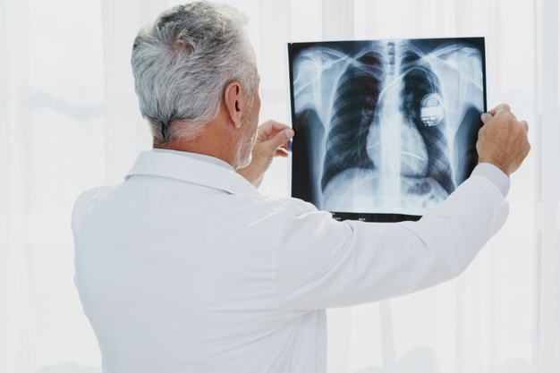
Existing System
Nowadays the cancer disease patients are increasing rapidly. The main reason behind it that the disease is not detected at early stage. The doctors or any medical consultant are manually analyzing the nodule by looking at CT scanned images. Which does not give the correct diagnosis in the early stage of disease. Sometime it is detected in the critical stage. There are many existing system which can work for detecting the lung nodule.

Slide 13
Disadvantages (Existing system)
Doctors can manually analyze the nodule for their CT images.
It is not gives the correct diagnosis in the early stage of disease.

Slide 14
Proposed System
In this system we use Lung image as a input and apply some techniques to identify the nodule of lung.
Otsu's thresholding method involves iterating through all the possible threshold values and calculating a measure of spread for the pixel levels each side of the threshold, i.e. the pixels that either fall in foreground or background.
Images are filtered for image segmentation by using watershed algorithm.
Segmentation using the watershed transform works better to identify, foreground objects and background locations.
GLCM feature that compute from the detected lung nodule in CT image. and finally we apply the SVM machine learning algorithm for detecting nodule of lung.

Slide 15
Key Contribution Work
Watershed technique
Otsus algorithm
Segmentation
Detection

Slide 16
Domain Analysis
Image Processing
Image processing is a method to perform some operations on an image, in order to get an enhanced image or to extract some useful information from it. It is a type of signal processing in which input is an image and output may be image or characteristics/features associated with that image. Nowadays, image processing is among rapidly growing technologies. It forms core research area within engineering and computer science disciplines too.
Image processing basically includes the following three steps:
Importing the image via image acquisition tools;
Analysing and manipulating the image;
Output in which result can be altered image or report that is based on image analysis.

Slide 17
Domain Analysis
Machine Learning
Machine learning is an application of artificial intelligence (AI) that provides systems the ability to automatically learn and improve from experience without being explicitly programmed. Machine learning focuses on the development of computer programs that can access data and use it learn for themselves.
Machine learning algorithms are often categorized as supervised or unsupervised
Supervised machine learning algorithms
unsupervised machine learning algorithms

Slide 18



SRS
Software Requirements
Language : Python 3
IDE : Pycharam
Database : MySQL
OpenCV
Performance Requirements
Response Time
Throughput
Accuracy
High Speed

Slide 19
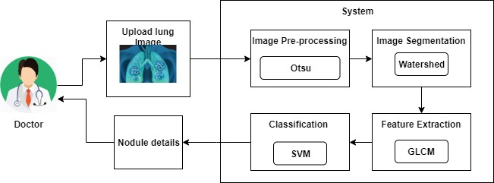
System Architecture

Slide 20
Models
Doctor
Upload lung image
View Result
Get Image
Preprocessing
Segmentation
Feature Extraction
Get nodule details.
Send detail to doctor
Admin

Slide 21
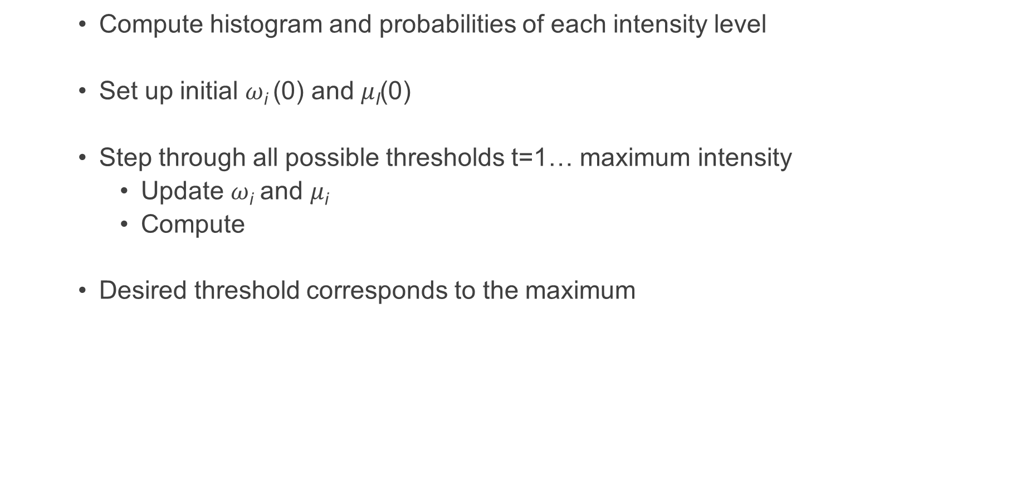
Algorithms
Otsu
Compute histogram and probabilities of each intensity level
Set up initial $ω$_{i} (0) and $μ$_{I}(0)
Step through all possible thresholds t=1… maximum intensity
Update $ω$_{i} and $μ$_{i}
Compute
Desired threshold corresponds to the maximum

Slide 22
Algorithms
Watershed
Compute a segmentation function. This is an image whose dark regions are the objects you are trying to segment.
Compute foreground markers. These are connected blobs of pixels within each of the objects.
Compute background markers. These are pixels that are not part of any object.
Modify the segmentation function so that it only has minima at the foreground and background marker locations.
Compute the watershed transform of the modified segmentation function.

Slide 23
Algorithms
SVM
It should separate the two classes A and B very well so that the function defined by:
f(x) = a.x + b is positive if and only if x E A
f(x) 0 if and only if x E B
It exists as far away as possible from all the observations (robustness of the model). Given that the distance from an observation x to the hyperplane is a.x+ b/a.
The width of the space between observations is 2/ a. It is called margin and it should be largest.
Hyperplane depends on support points called the closest points.
Generalization capacity of SVM increases as the number of support points decreases.

Slide 24
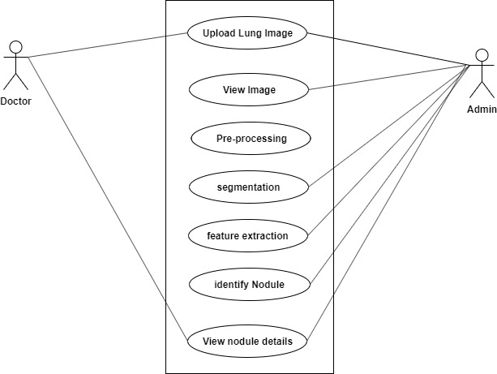
UML Diagrams Use Case :-

Slide 25
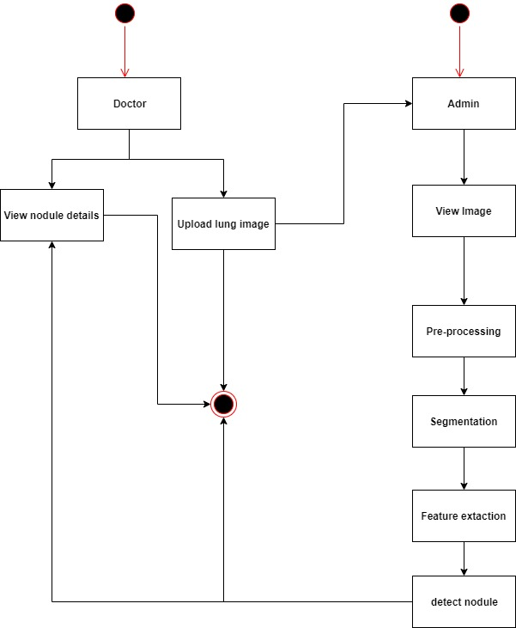
UML Diagrams Activity :-

Slide 26
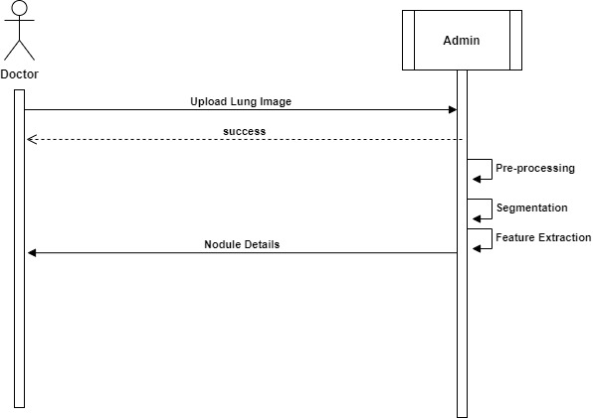
UML Diagrams Sequence

Slide 27
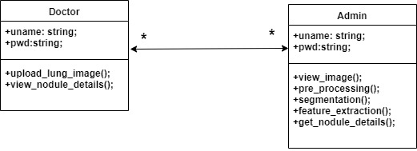
UML Diagrams Class

Slide 28
Conclusion
Our simulations showed that it is feasible to quantify sub-cm nodules within 20% bias using low-dose PET in the simulation. However, more thorough validations using clinically realistic phantoms should be performed.
Reconstruction voxel size of 1 mm is recommended for small nodules. Respiratory motion correction is critical for nodules in the lung and abdomen. This project get accurate nodule size by using Otsu, Watershed, GLCM, and SVM.

Slide 29
References :-
[1] Rekka Mastouri, Henda Neji, Saoussen Hantous-Zannad, Nawres Khlifa, “A morphological operation-based approach for Subpleural lung nodule detection from CT images”, 4th Middle East Conference on Biomedical Engineering (MECBME), IEEE, 2018.
[2] R. L. Siegel, K. D. Miller, and A. Jemal, “Cancer statistics, 2016,” CA Cancer J. Clinicians, vol. 66, no. 1, pp. 7–30, 2016.
[3] F. C. Detterbeck, P. J. Mazzone, D. P. Naidich, and P. B. Bach, “Screening for lung cancer: Diagnosis and management of lung cancer, 3rd ed: American College of chest physicians evidence-based clinical practice guidelines,” Chest, vol. 143, no. 5, pp. E78S–E92S, May 2013.
[4] P. B. Bach et al., “Benefits and harms of CT screening for lung cancer: A systematic review,” J. Amer. Med. Assoc., vol. 307, no. 22, pp. 2418–2429, Jun. 2012.
[5] W. C. Hanna et al., “Minimal-dose computed tomography is superior to chest X-ray for the follow-up and treatment of patients with resected lung cancer,” J. Thoracic Cardiovasc. Surgery, vol. 147, no. 1, pp. 30–35, Jan. 2014.

Slide 30
Screenshots

Slide 31
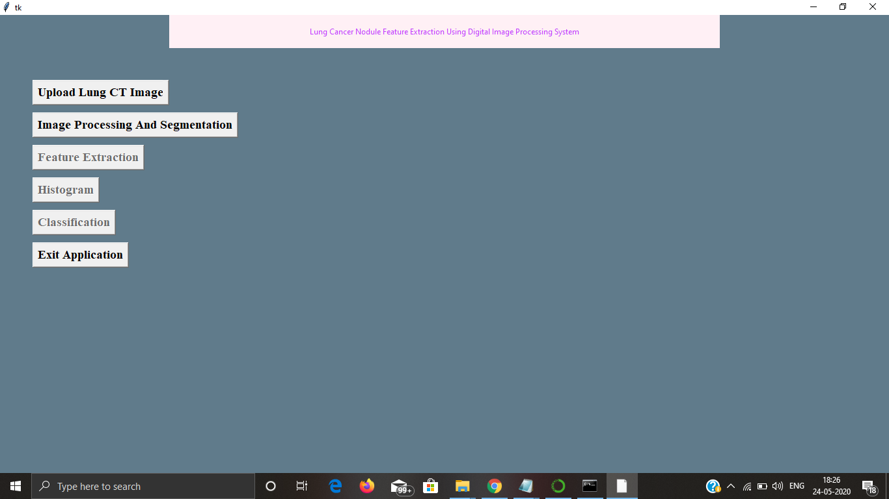
Main screen window

Slide 32
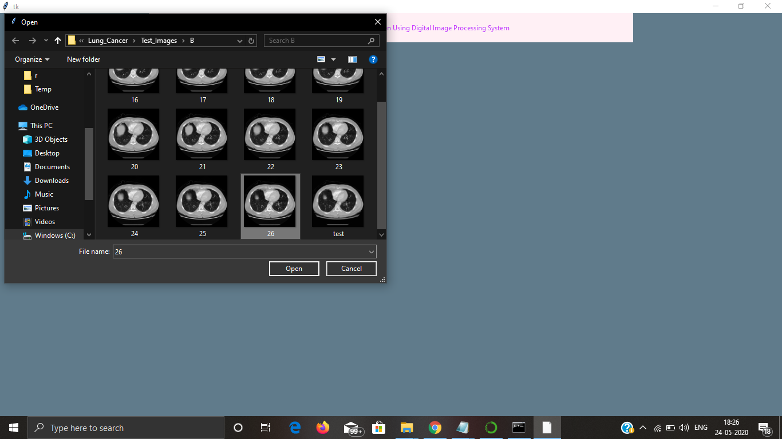
Upload CT scan image

Slide 33
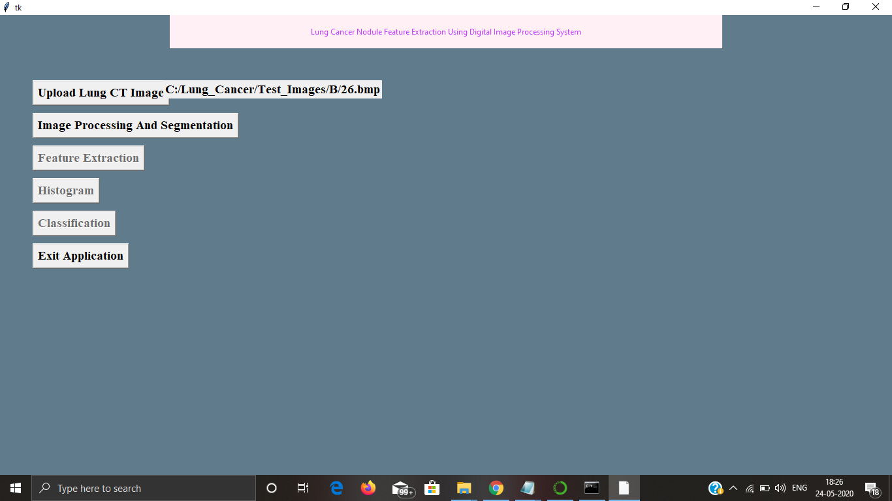
File path of uploaded image

Slide 34
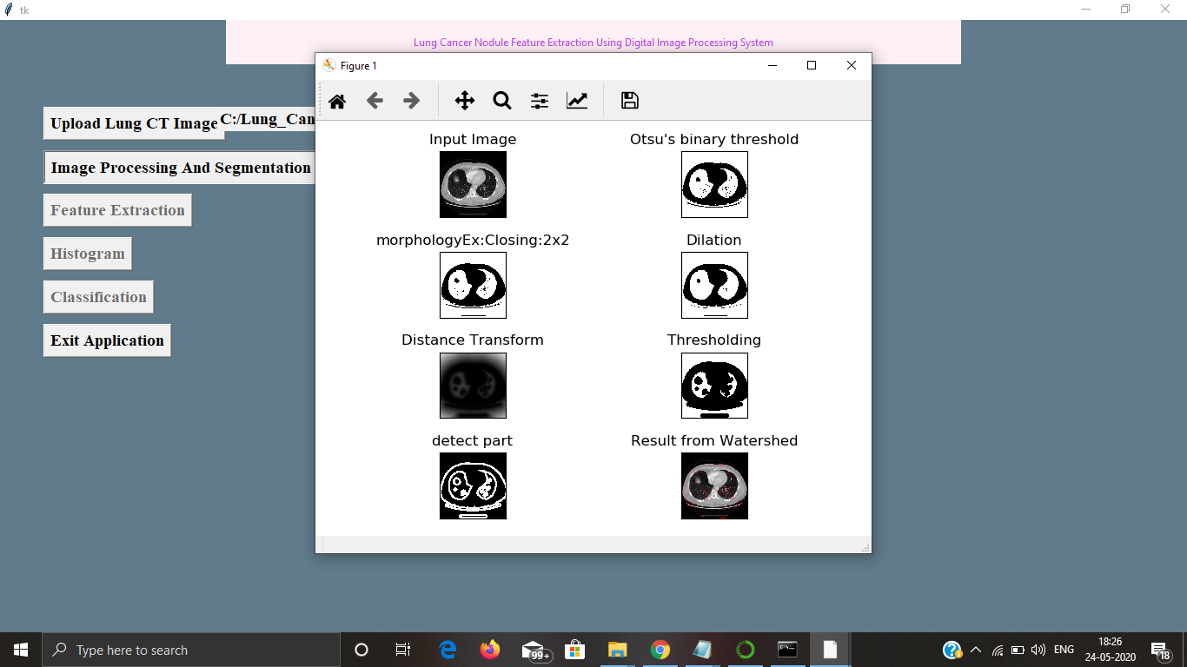
Image processing and segmentation

Slide 35
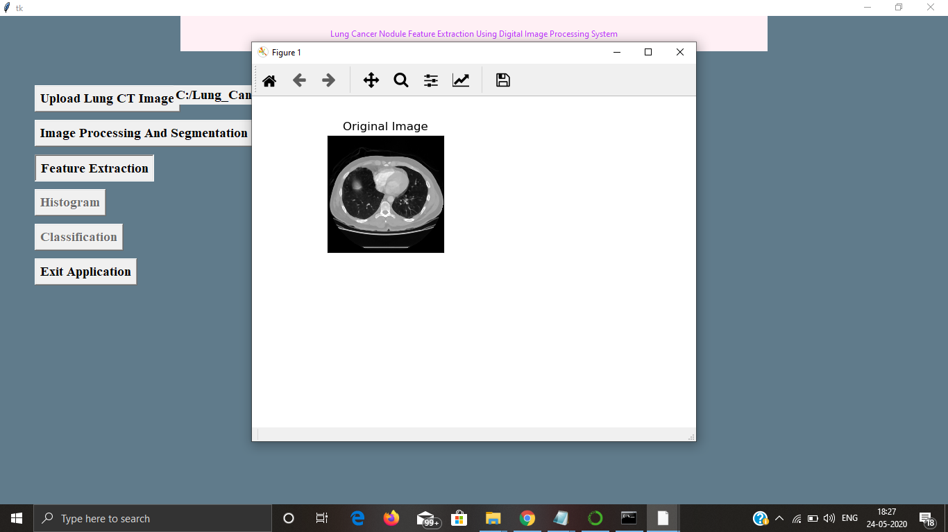
Feature extraction – original image

Slide 36
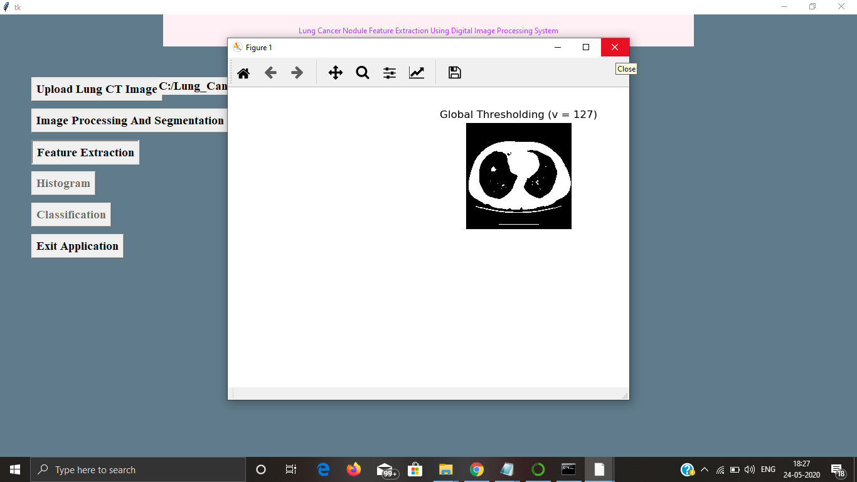
Feature extraction – global thresholding

Slide 37
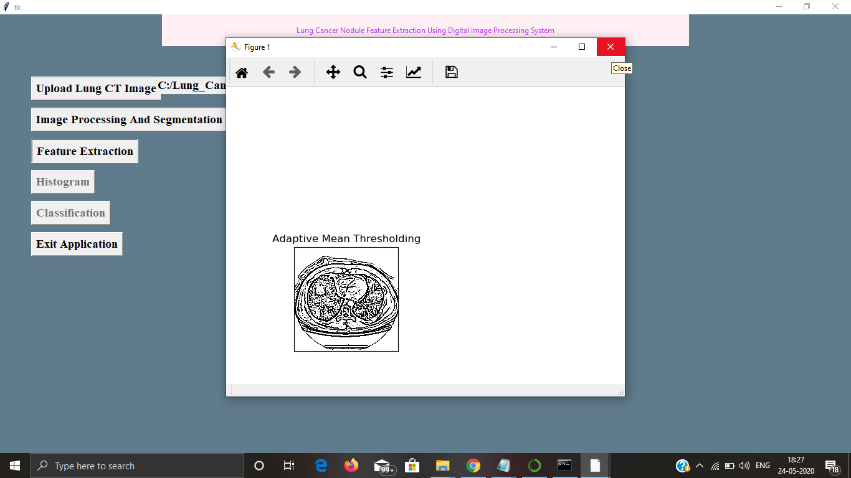
Feature extraction – adaptive mean

Slide 38
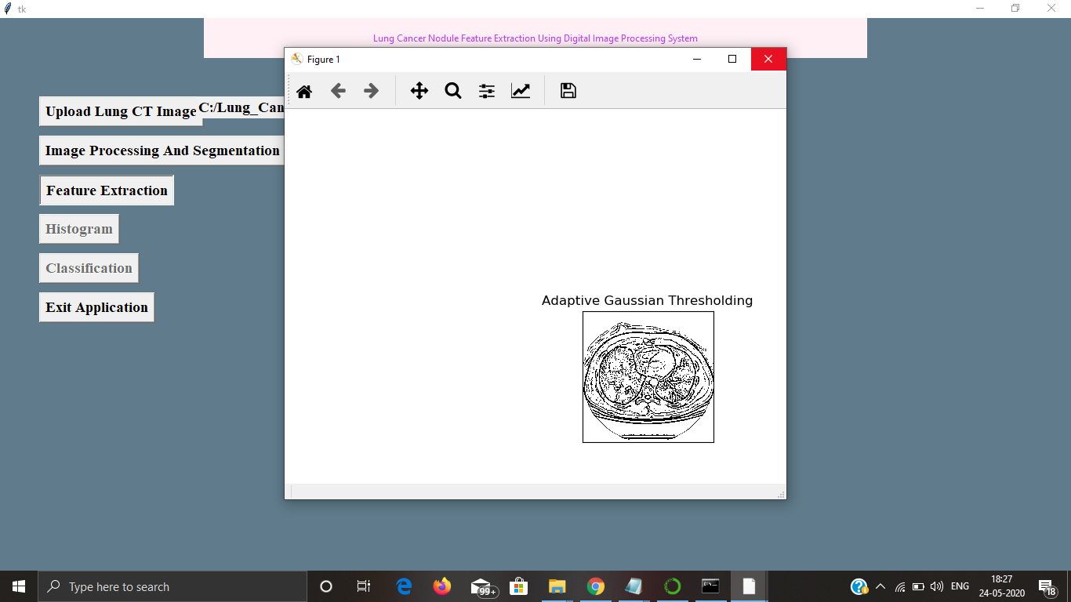
Feature extraction – adaptive guassian

Slide 39
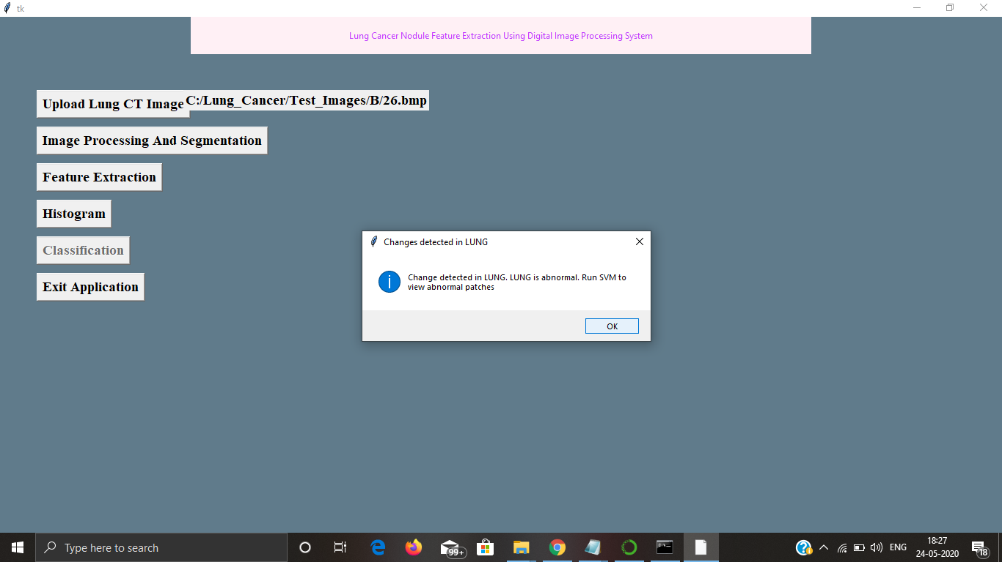
Histogram – dialogue box with status

Slide 40
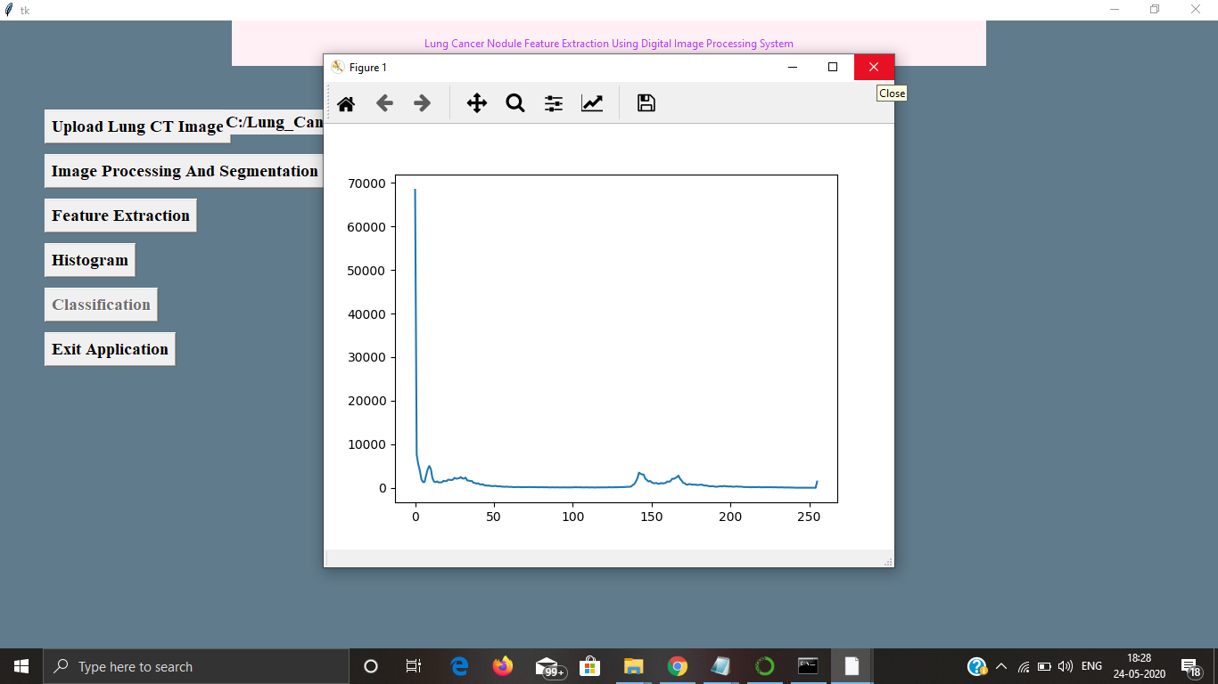
Histogram

Slide 41
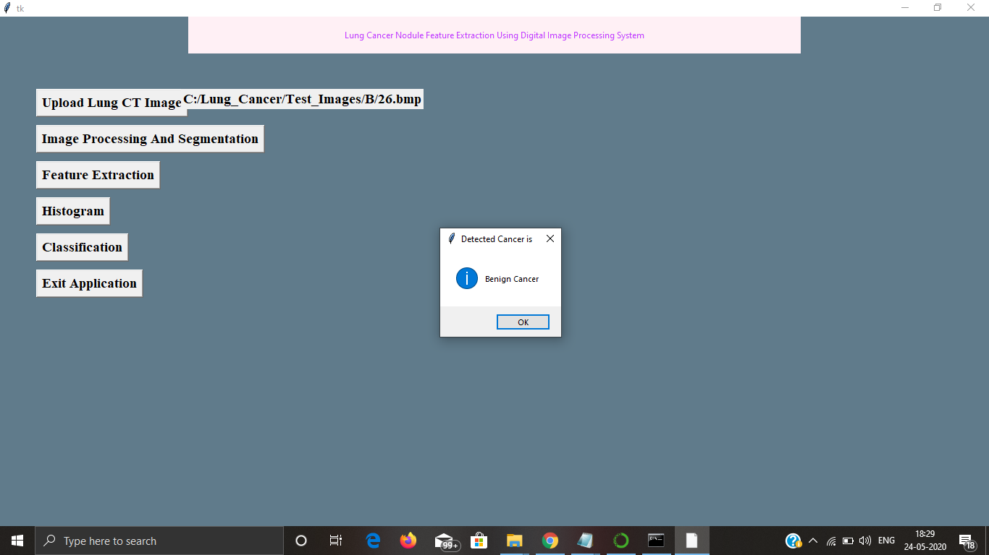
Classification – cancer status

Slide 42
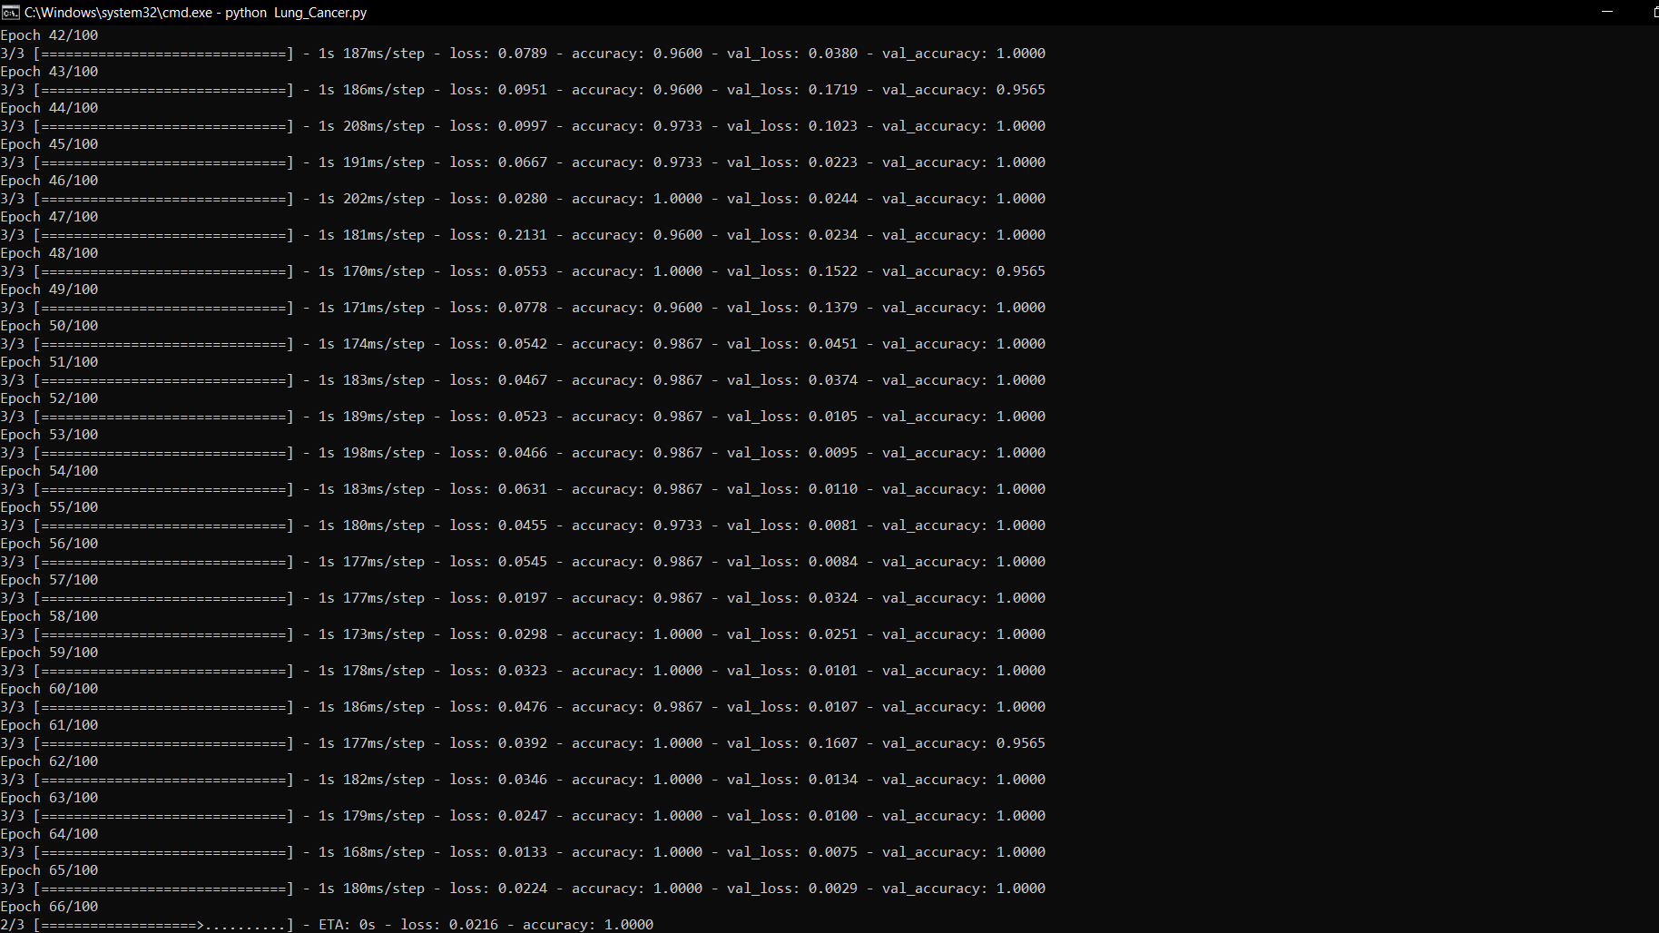
Snapshot of data training for classification

Slide 43
Thank You!

